Slide 1
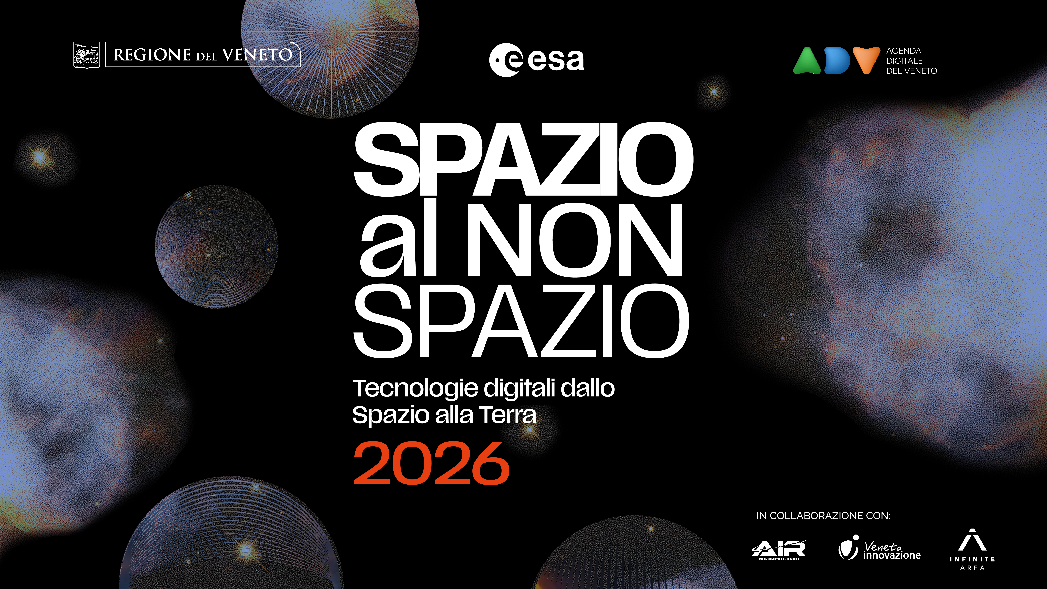

Slide 2

L’iniziativa InCubed a supporto delle PMI per accedere ai bandi ESA
Antonio Altana– ESA InCubed Ambassador
a.altana@stamtech.com
16/04/2026

Slide 3
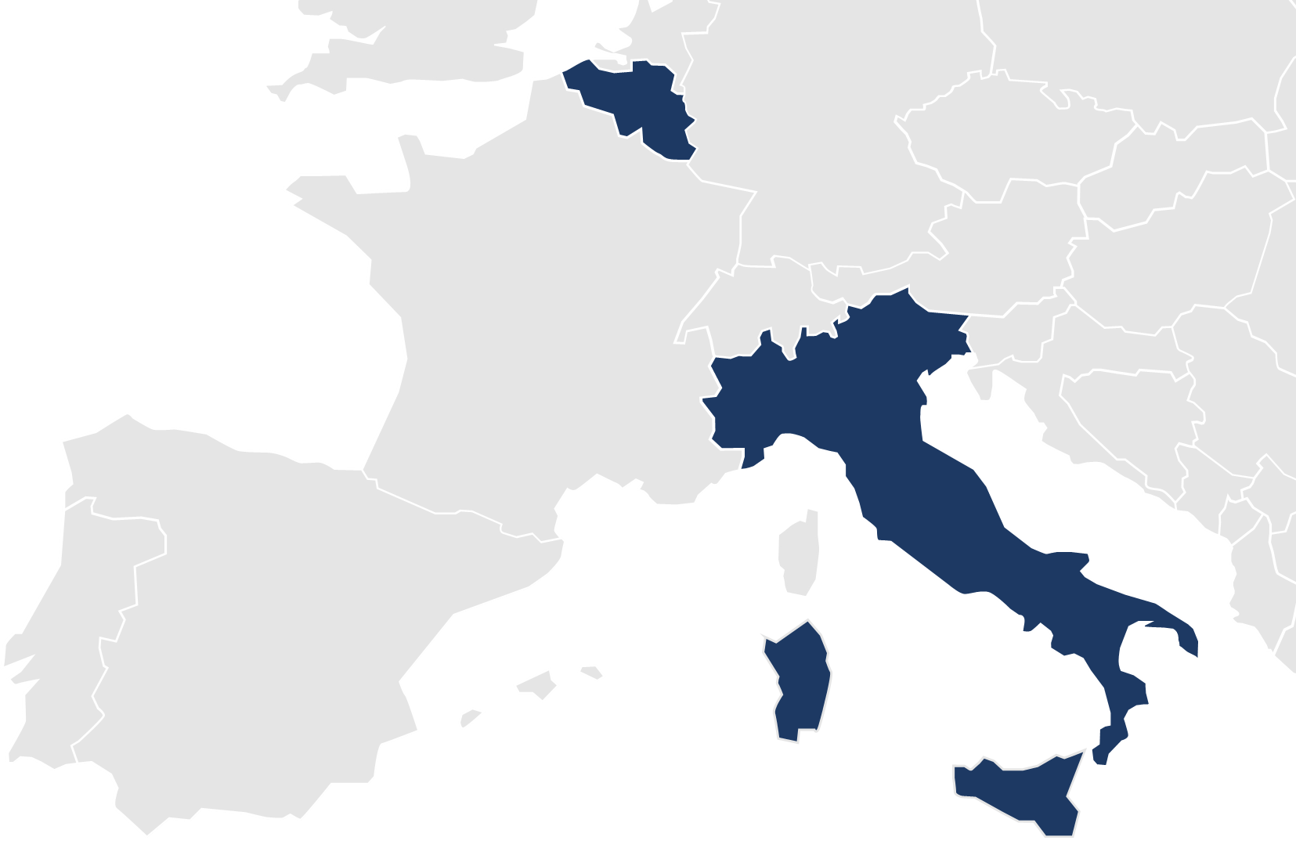

STAM Today
BRUXELLES
120+
EMPLOYEES
OUR OFFICES
36
AVERAGE AGE
PADUA
28
YEARS OF ACTIVITY
HQ
GENOA
12
M€ TURNOVER
BARI
ROME
25%
Growth YOY
CAGLIARI

Slide 4

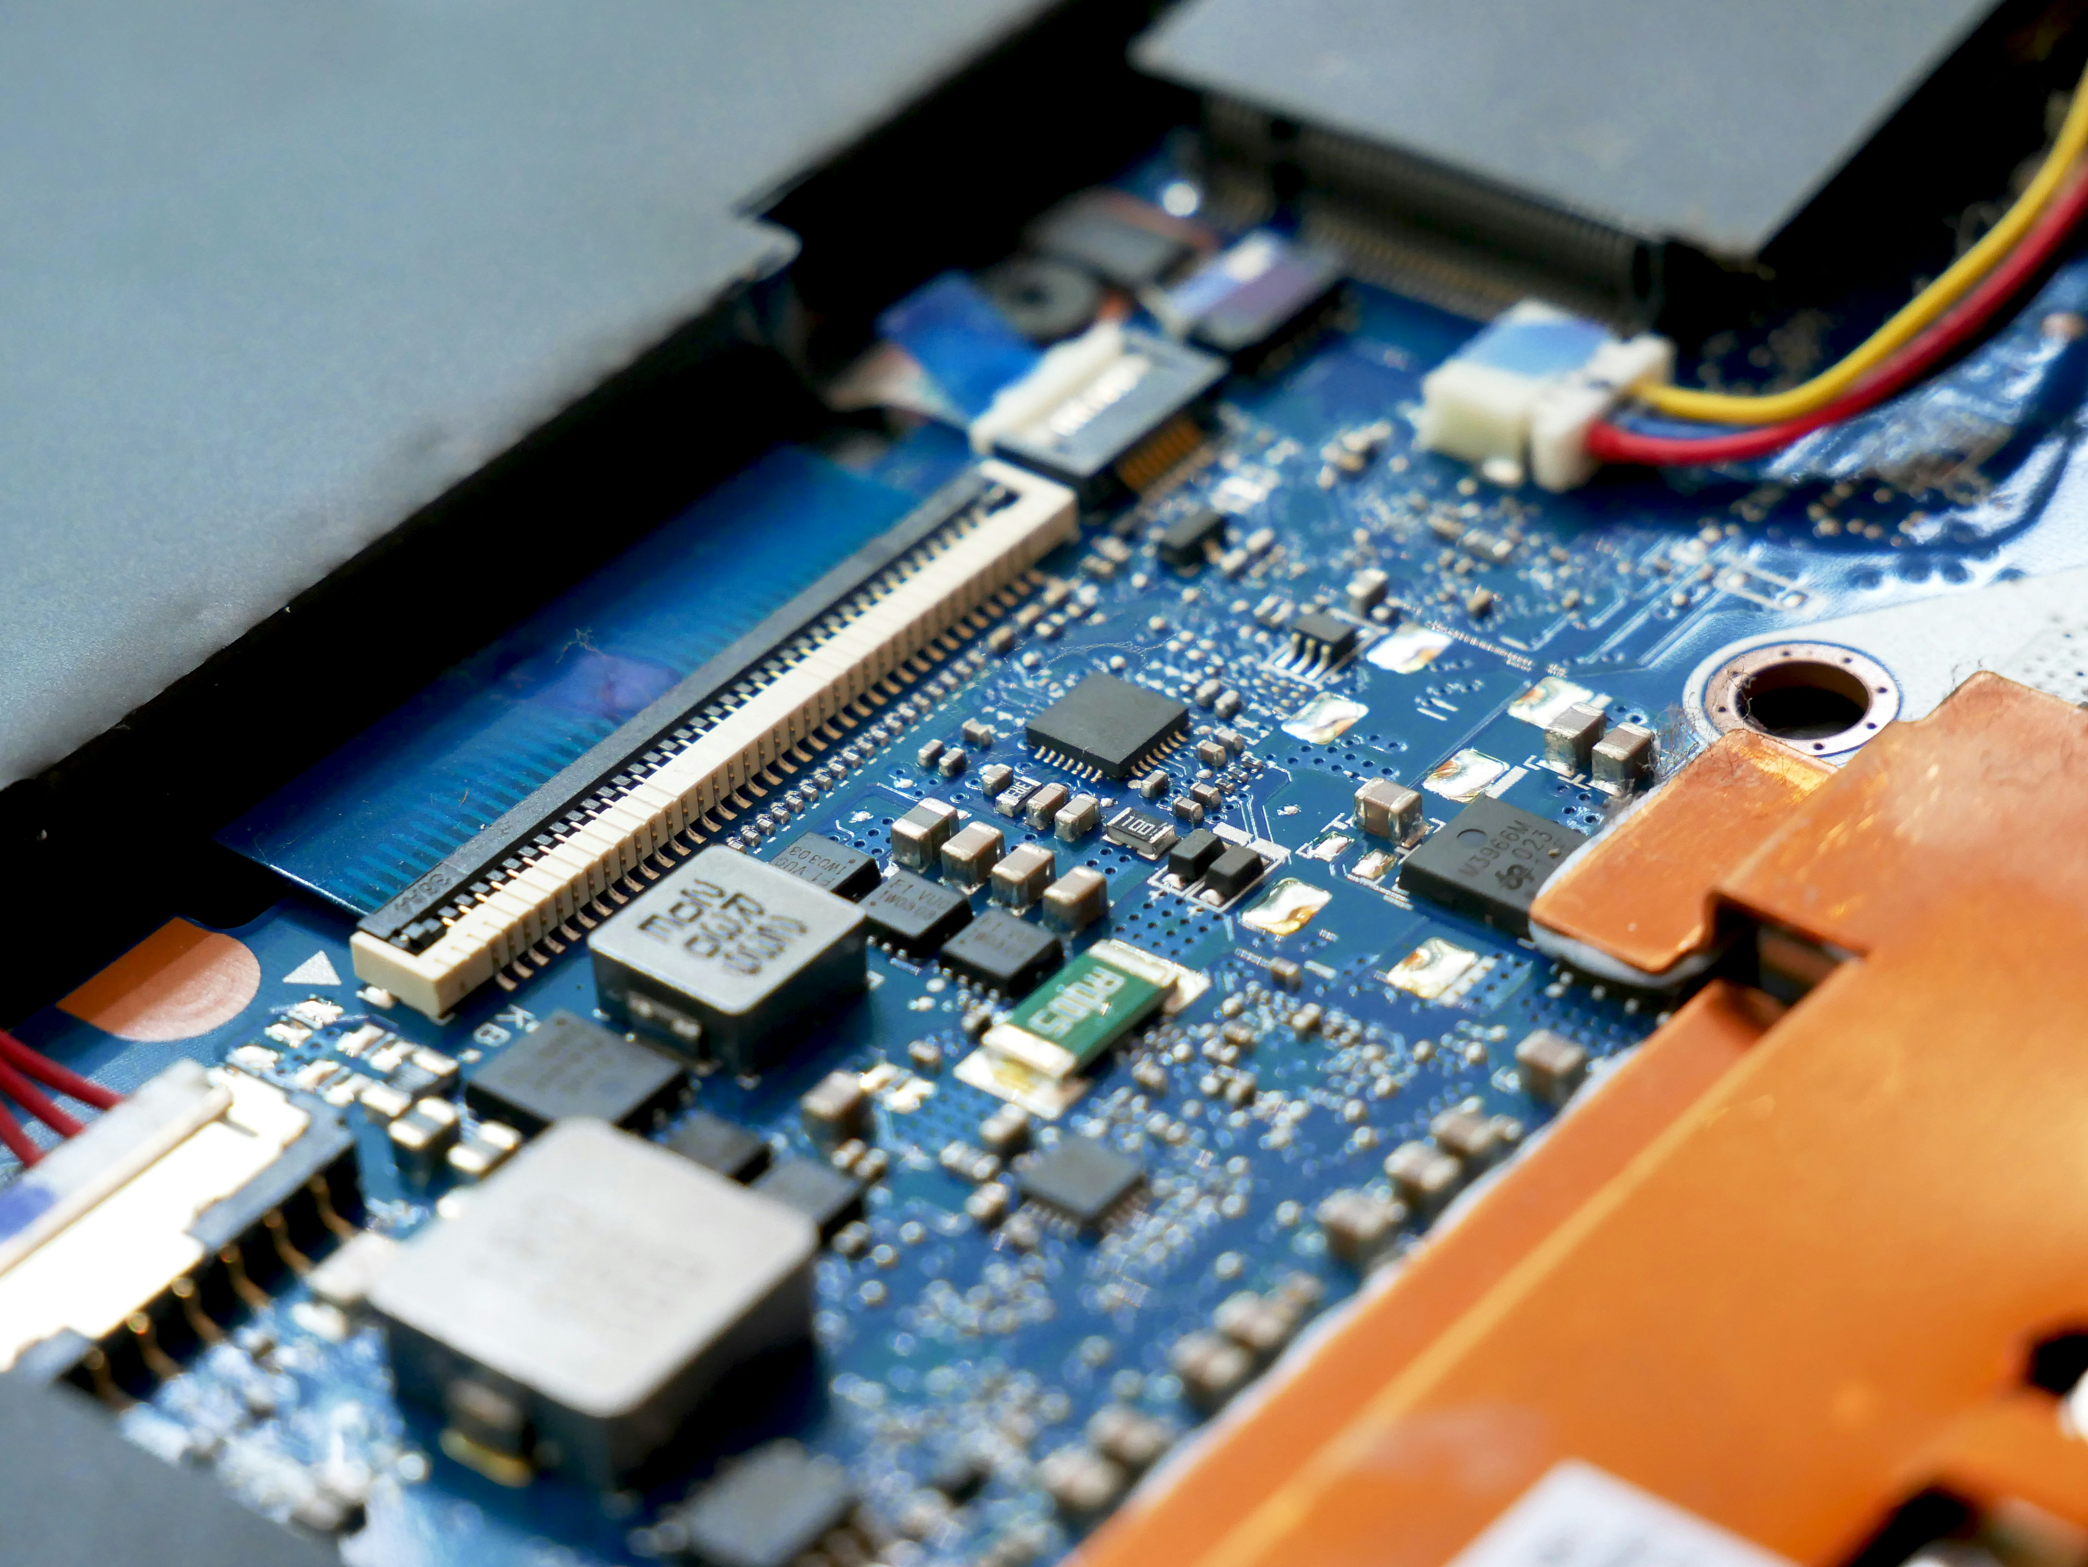

How we deliver: our labs and competence areas
ENGINEERING, TECHNOLOGY AND MANAGEMENT SUPPORT
ROBOTICS & AUTOMATION
DIGITAL SOLUTIONS & AI
ENERGY & SUSTAINABILITY
Collaborative Robotics & Autonomous Systems Lab
Digital Twin & Immersive Simulation Lab
Photo-Bioreactor and Life Support Systems Lab
LABORATORIES

Slide 5
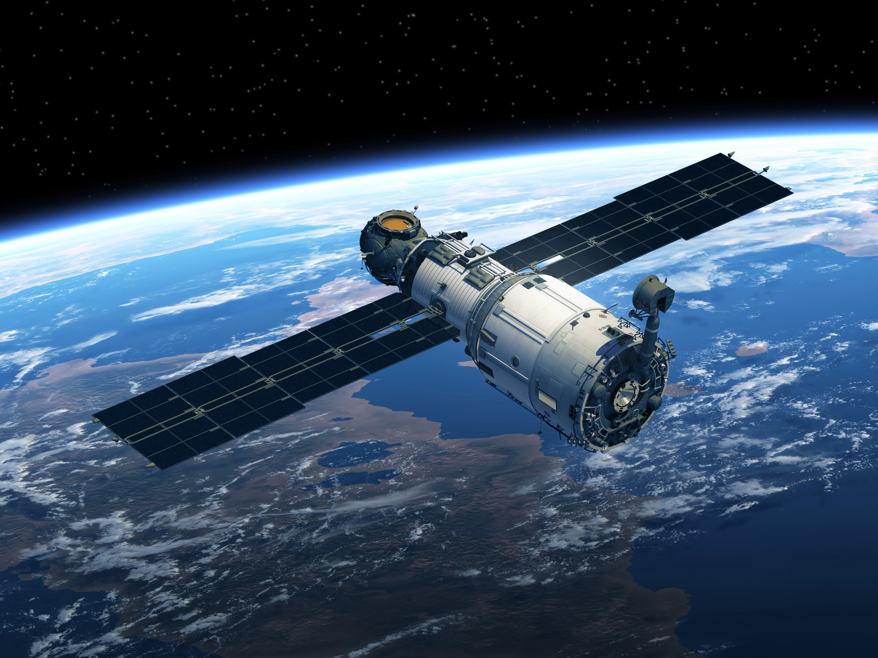
InCubed and the ESA Φ-lab
InCubed is an ESA programme managed by the Φ-lab INVEST Office.
It is a Public Private Partnership co-funding programme (“Investing in Industrial Innovation”) that supports the development of innovative, commercially viable EO products and services based on Earth observation imagery and datasets.
The programme covers the full EO value chain: from building satellites to ground applications and new EO business models.
Project size 100k€ to >25M€
Funding rate up to 80%

Slide 6
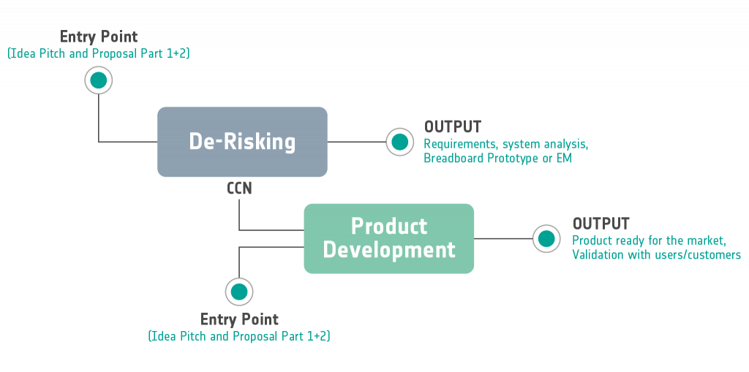
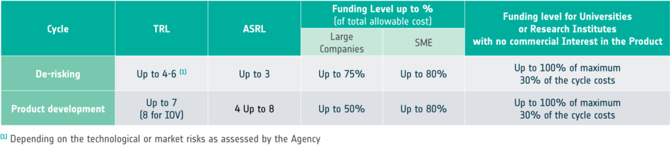
InCubed Process

Slide 7
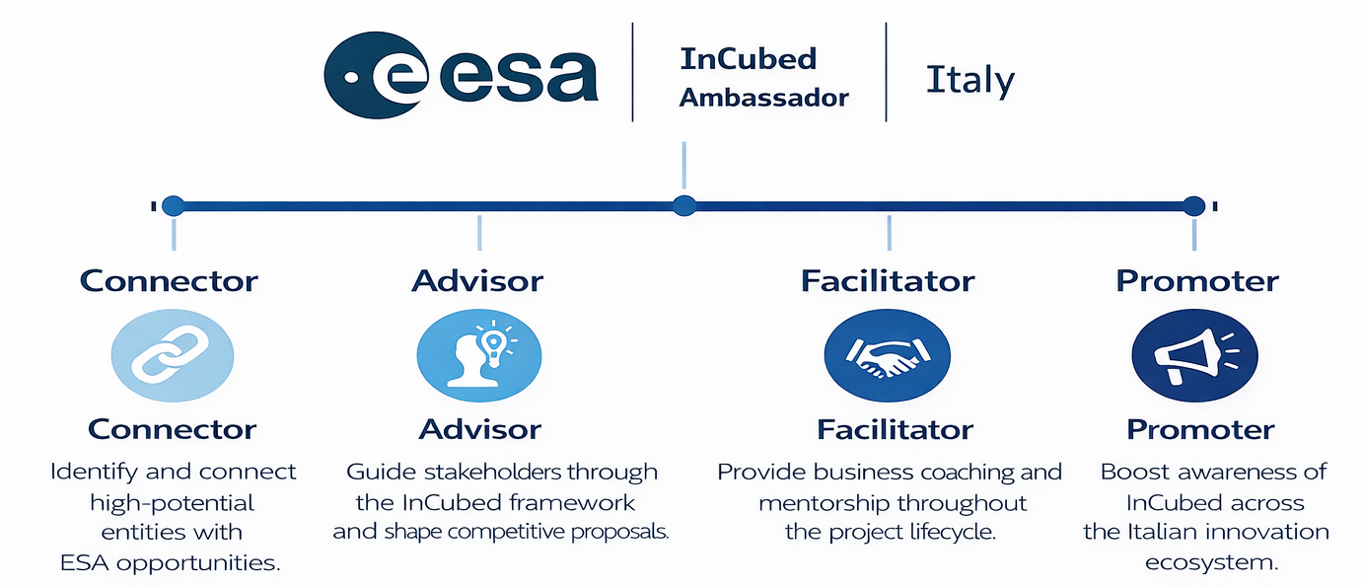

The role of the ESA InCubed Ambassador
We help companies access, navigate, and succeed in the programme
in close collaboration with ESA and liasing with ASI.
Connector
Identify and connect high-potential entities with ESA opportunities.
Advisor
Guide stakeholders through the InCubed framework and shape competitive proposals.
Facilitator
Provide business coaching and mentorship throughout the project lifecycle.
Promoter
Boost awareness of InCubed across the Italian innovation ecosystem.

Slide 8
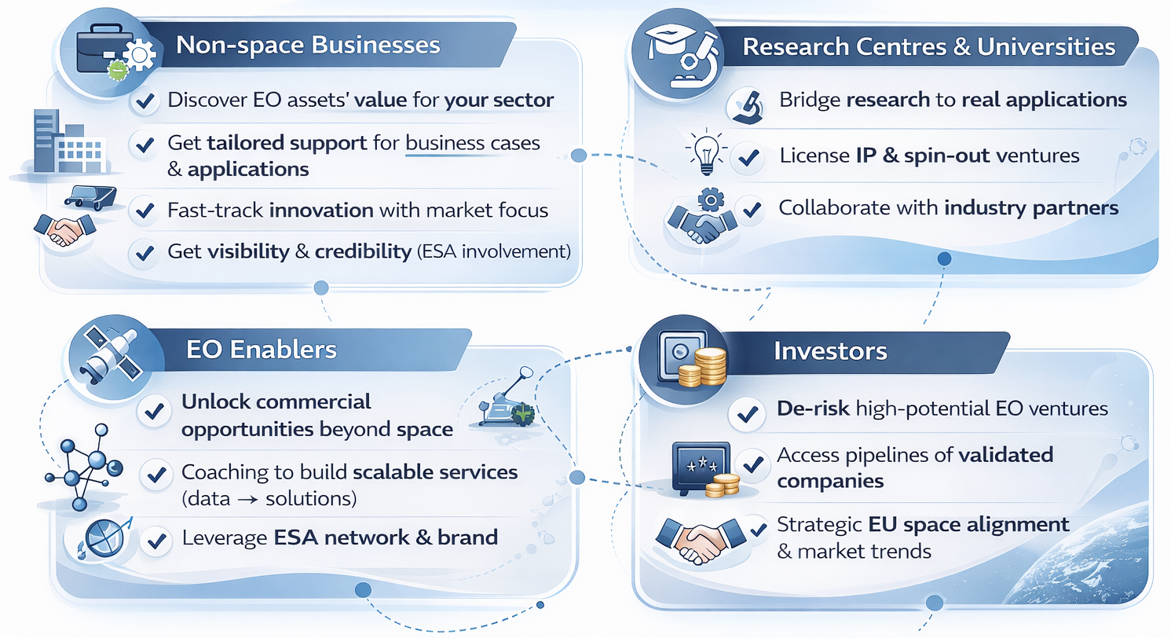
Connecting Stakeholders to Opportunity

Slide 9
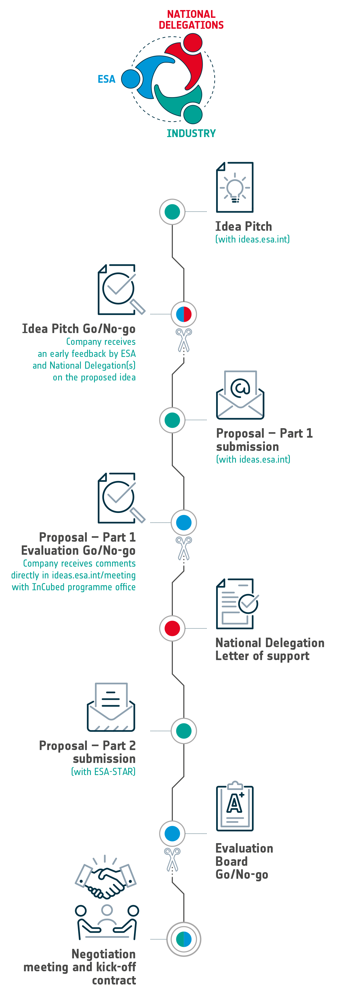
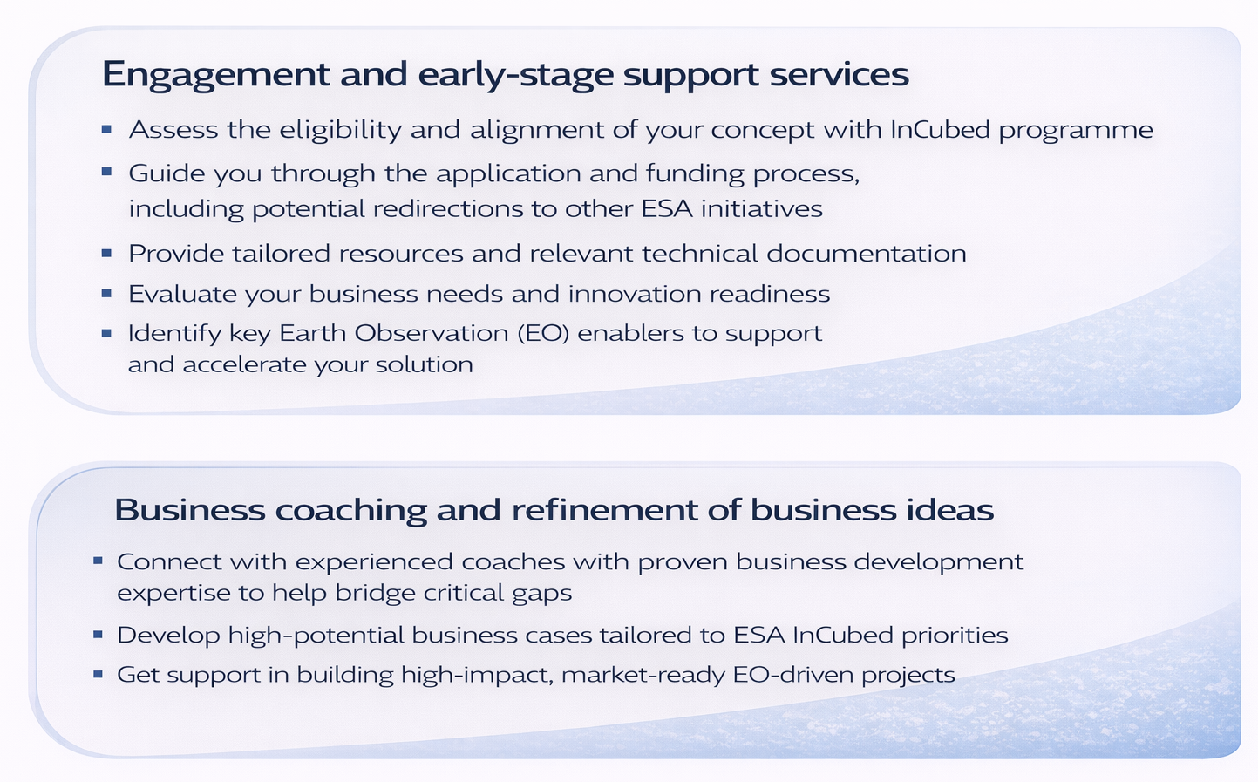
Our business support along the journey
Engagement and early-stage support services
Assess the eligibility and alignment of your concept with InCubed programme
Guide you through the application and funding process, including potential redirections to other ESA initiatives
Provide tailored resources and relevant technical documentation
Evaluate your business needs and innovation readiness
Identify key Earth Observation (EO) enablers to support and accelerate your solution
Business coaching and refinement of business ideas
Connect with experienced coaches with proven business development expertise to help bridge critical gaps
Develop high-potential business cases tailored to ESA InCubed priorities
Get support in building high-impact, market-ready EO-driven projects

Slide 10

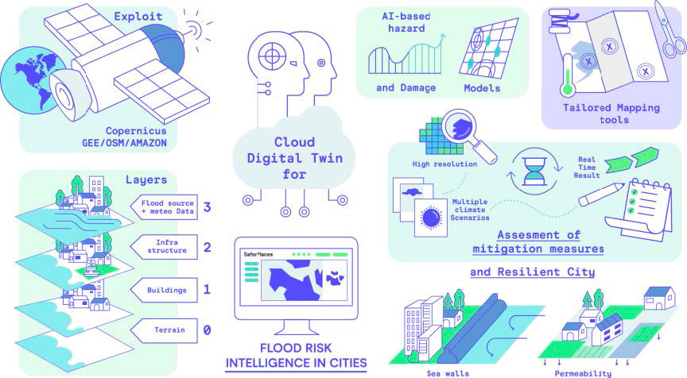
Some project examples for inspiration (1/3)
SaferPlaces: an AI-based digital twin platform for flood risk intelligence in urban areas
Application: EO-driven platform using artificial intelligence to quantify physical climate risks (e.g. floods, wildfires, extreme heat) and support resilience planning for assets, territories and portfolios
Partners: GECOsistema, MEEO
Target Stakeholders: Insurance and reinsurance, banks and investors, public authorities, infrastructure operators, corporate risk teams.
Relevance:
Shows how EO + AI enable operational climate risk analytics for real-world decision making
Bridges space data with financial, infrastructure and urban resilience use cases
Demonstrates scalable downstream EO services aligned with ESG and adaptation needs

Slide 11

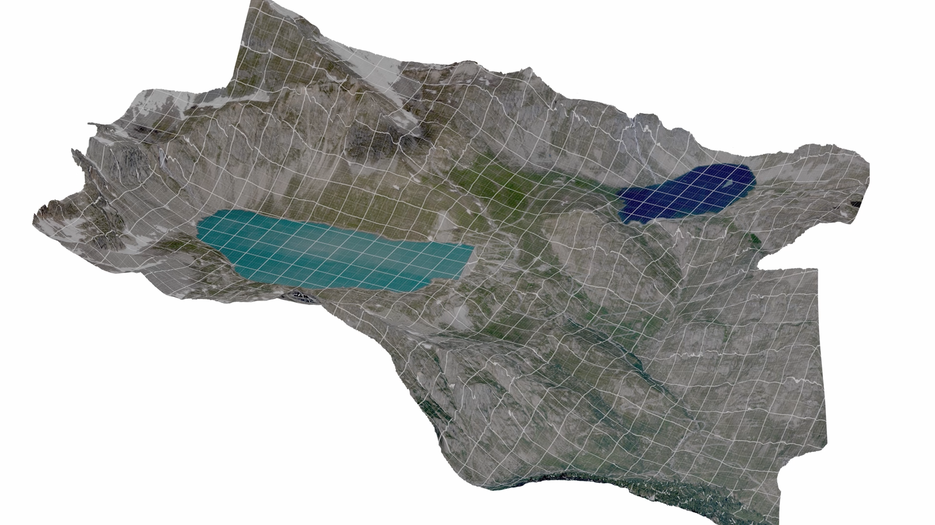
Some project examples for inspiration (2/3)
Skymetry: Ground Motion Digital Twin
Application: EO‑driven monitoring service that uses InSAR and other satellite data to build a digital twin of ground and infrastructure stability, tracking subsidence and deformation over time and delivering early‑warning insights for risk and maintenance planning.
Partners: DigiSky, StudioMapp
Target Stakeholders: Infrastructure managers (roads, rail, bridges), utilities and pipeline operators, cities and public authorities, engineering and insurance companies needing continuous, objective ground‑motion intelligence for risk management and planning.
Relevance:
Shows how EO‑based ground motion monitoring can become a digital twin of terrain and infrastructure stability, not just a static map.
Bridges satellite data and operational asset management, enabling earlier interventions, better maintenance planning and reduced failure risk.
Demonstrates a repeatable service model that can scale across regions and sectors, turning subsidence and deformation data into actionable business value for non‑space markets.

Slide 12


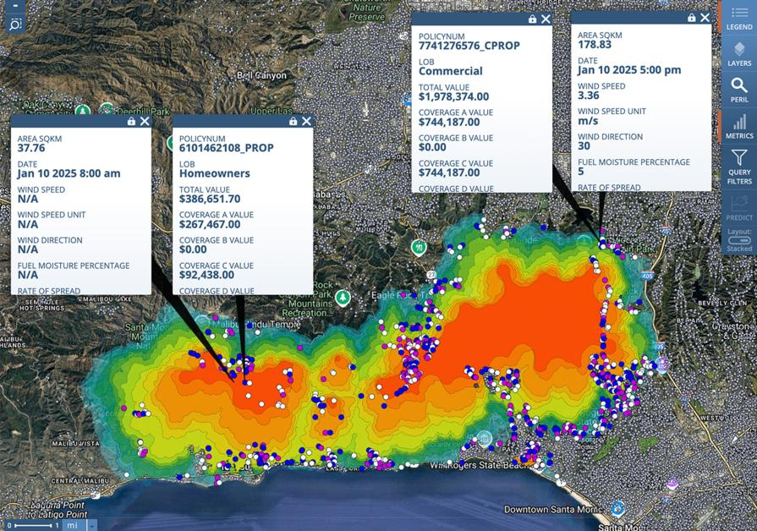
Some project examples for inspiration (3/3)
Forest-3: AI-powered thermal EO for a global wildfire digital twin
Application: End-to-end wildfire intelligence service that fuses thermal infrared data from more than 27 satellites – including OroraTech’s own CubeSats – with AI analytics to detect, monitor and forecast wildfires in near real time.
Partners: OroraTech
Target Stakeholders: Forestry and environmental agencies, civil protection and emergency services, utilities and grid operators, insurers and large land/asset owners exposed to wildfire risk..
Relevance:
Shows how EO + AI thermal data enable a wildfire digital twin, improving extreme weather and fire‑risk prediction.
Bridges space assets and NVIDIA Earth‑2, turning satellite data into a continuous simulation layer for operational decisions.
Demonstrates a scalable, subscription‑based service model for non‑space customers, beyond one‑off pilots or projects..

Slide 13
Antonio Altana
a.altana@stamtech.com

