Slide 1


Slide 2

Le iniziative di ESA a supporto delle PMI nell’ambito Osservazione della Terra
Stefano Carosio – ESA InCubed Ambassador
s.carosio@stamtech.com
24/02/2026

Slide 3





STAM Today
PADUA
120
STAFF
35
AVERAGE AGE
HQ
GENOA
OUR OFFICES
28
YEARS IN BUSINESS
ROME
BARI
12
M€ TURNOVER
25%
Growth YOY
CAGLIARI

Slide 4

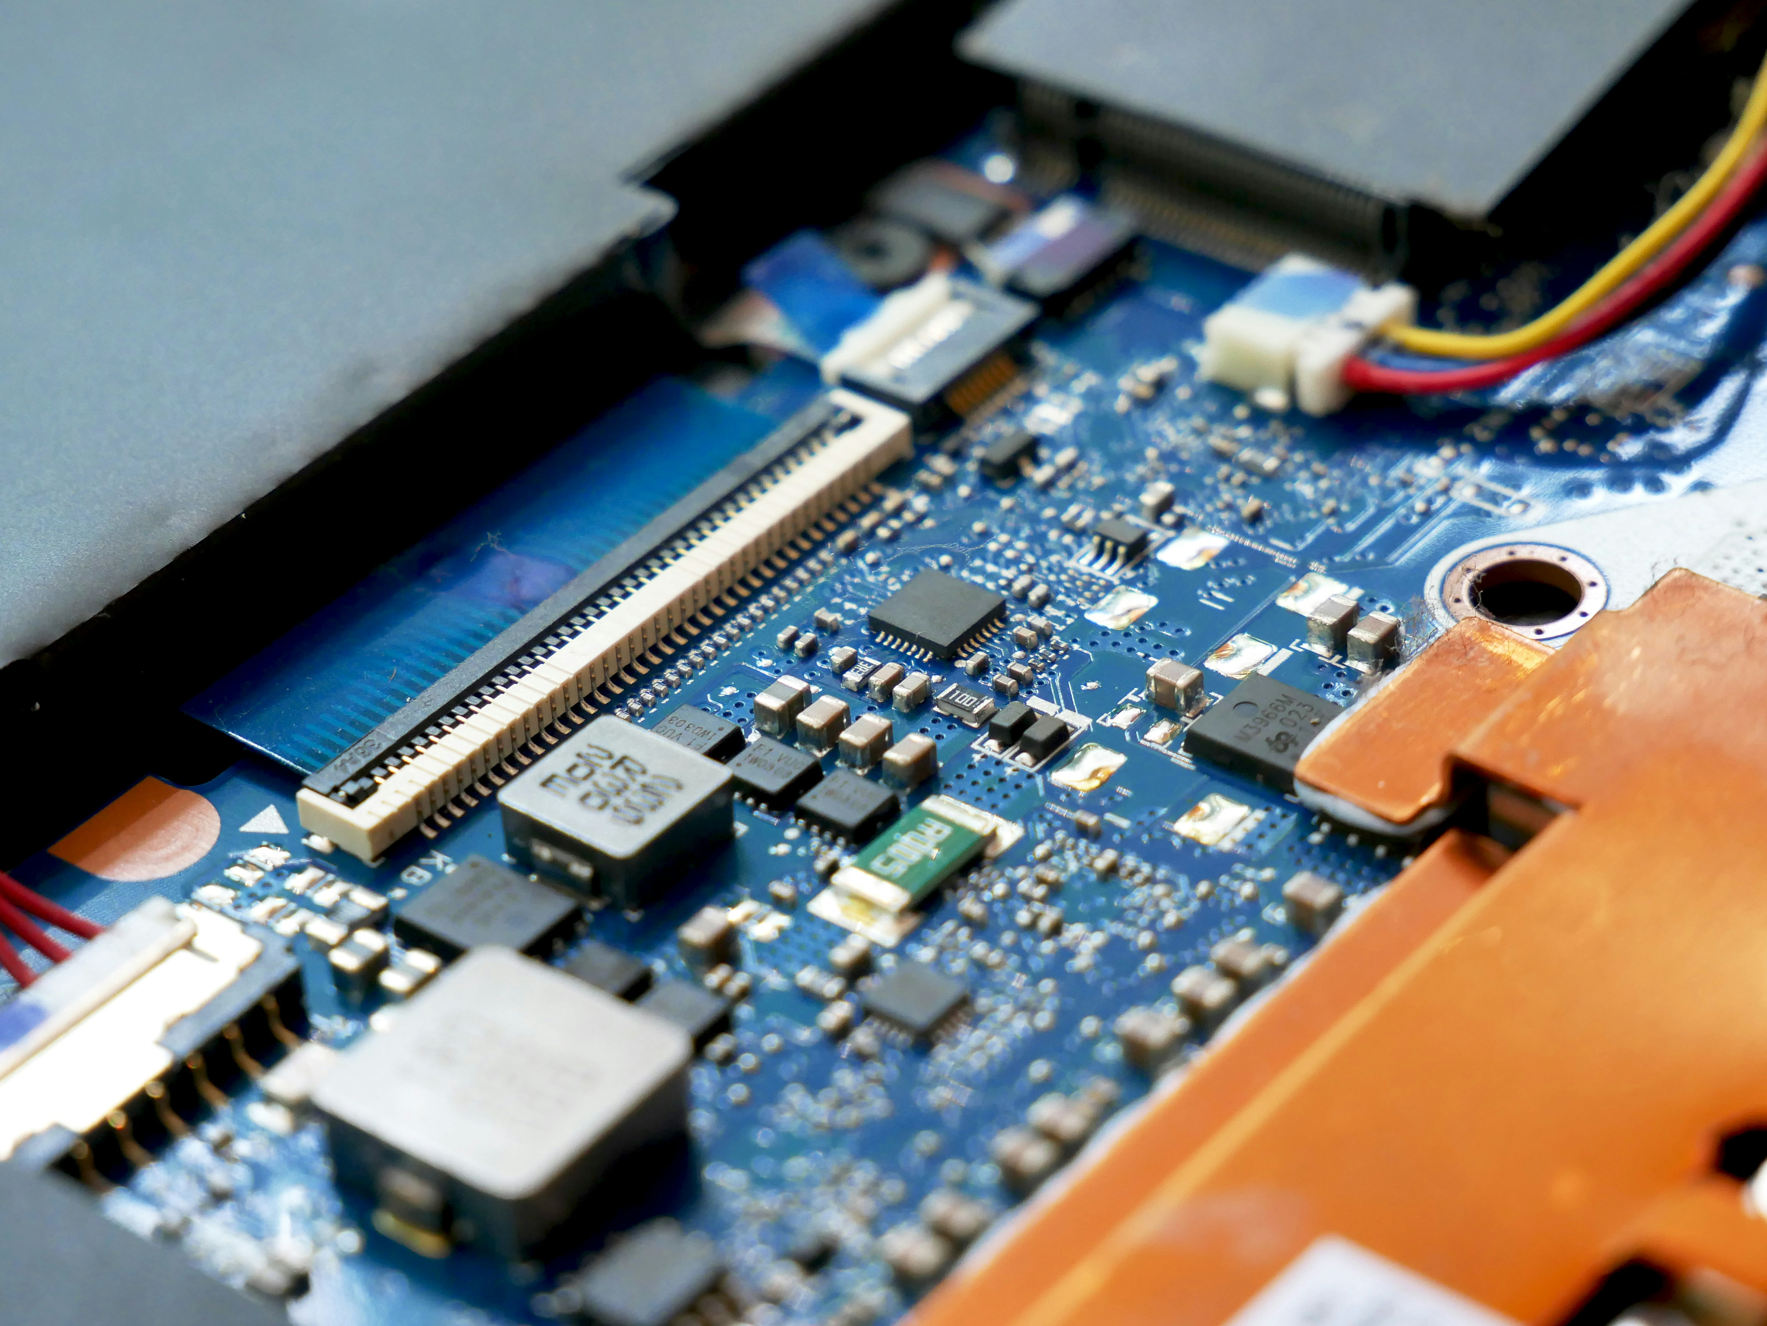

How we deliver: our labs and competence areas
ENGINEERING, TECHNOLOGY AND MANAGEMENT SUPPORT
ROBOTICS & AUTOMATION
DIGITAL SOLUTIONS & AI
ENERGY & SUSTAINABILITY
Collaborative Robotics & Autonomous Systems Lab
Digital Twin & Immersive Simulation Lab
Photo-Bioreactor and Life Support Systems Lab
LABORATORIES

Slide 5
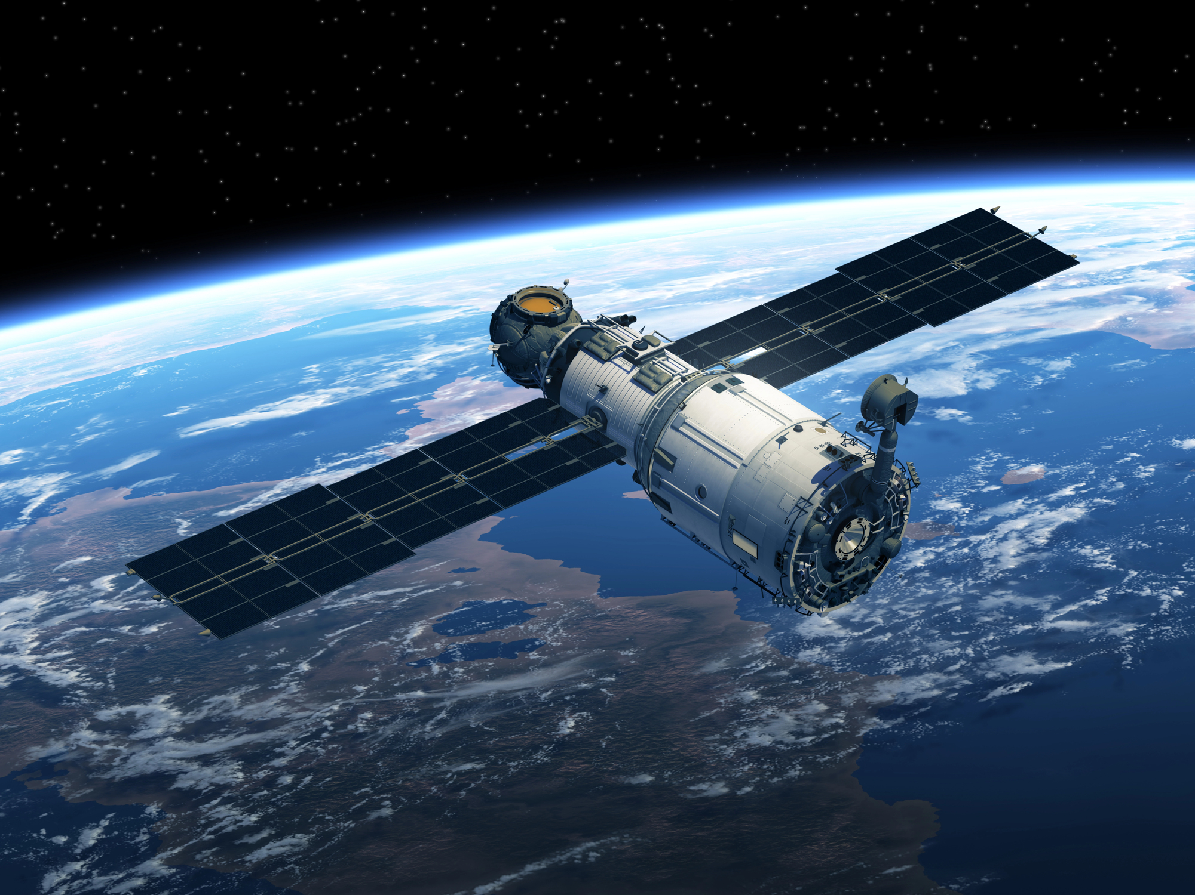
InCubed and the ESA Φ-lab
InCubed is an ESA programme managed by the Φ-lab INVEST Office.
It is a Public Private Partnership co-funding programme (“Investing in Industrial Innovation”) that supports the development of innovative, commercially viable EO products and services based on Earth observation imagery and datasets.
The programme covers the full EO value chain: from building satellites to ground applications and new EO business models.
Project size 100k€ to >25M€
Funding rate up to 80%

Slide 6
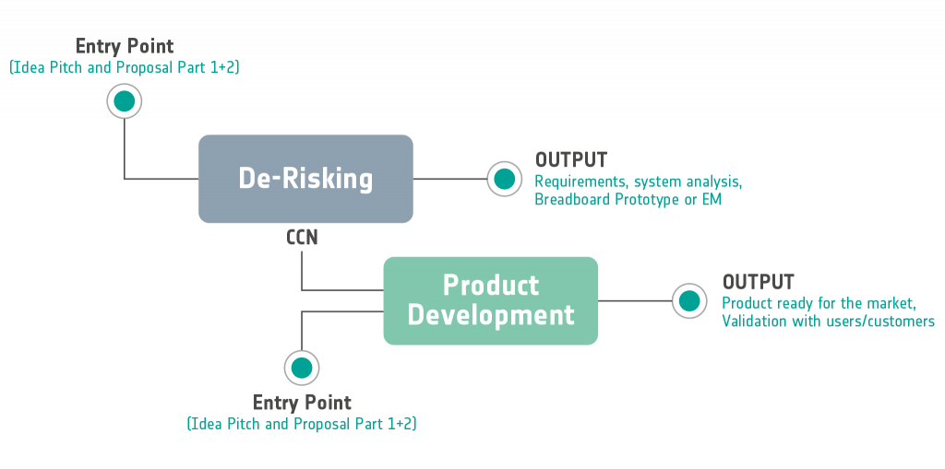
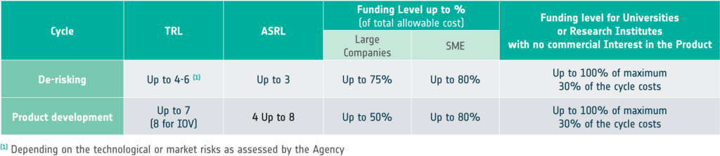
InCubed Process

Slide 7
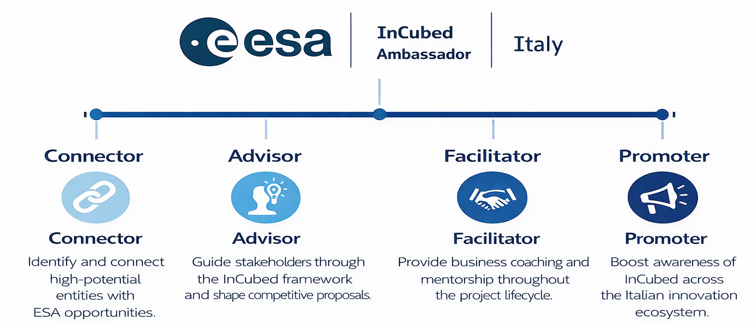





The role of the ESA InCubed Ambassador
We help companies access, navigate, and succeed in the programme
in close collaboration with ESA and liasing with ASI.
Connector
Identify and connect high-potential entities with ESA opportunities.
Advisor
Guide stakeholders through the InCubed framework and shape competitive proposals.
Facilitator
Provide business coaching and mentorship throughout the project lifecycle.
Promoter
Boost awareness of InCubed across the Italian innovation ecosystem.

Slide 8
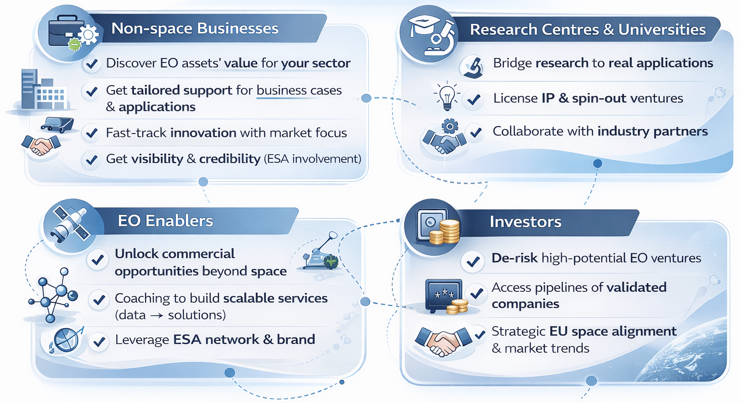
Connecting Stakeholders to Opportunity

Slide 9
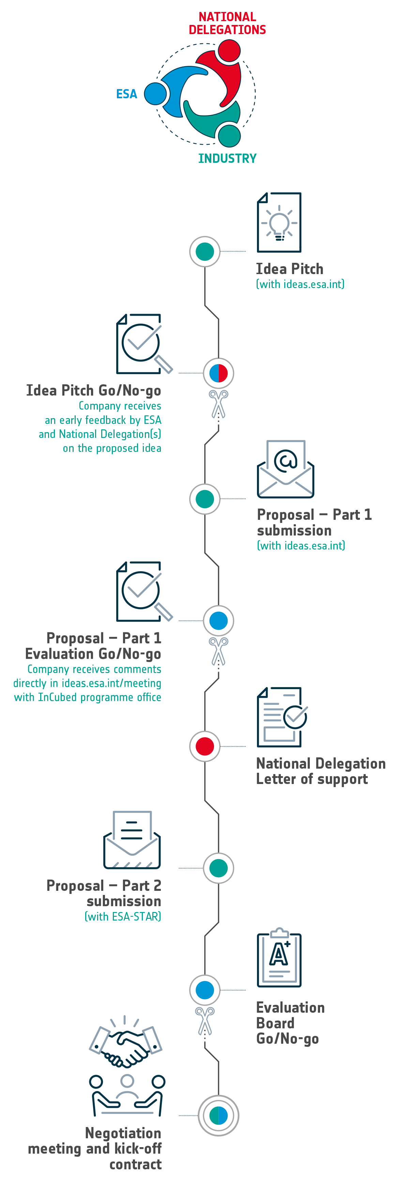
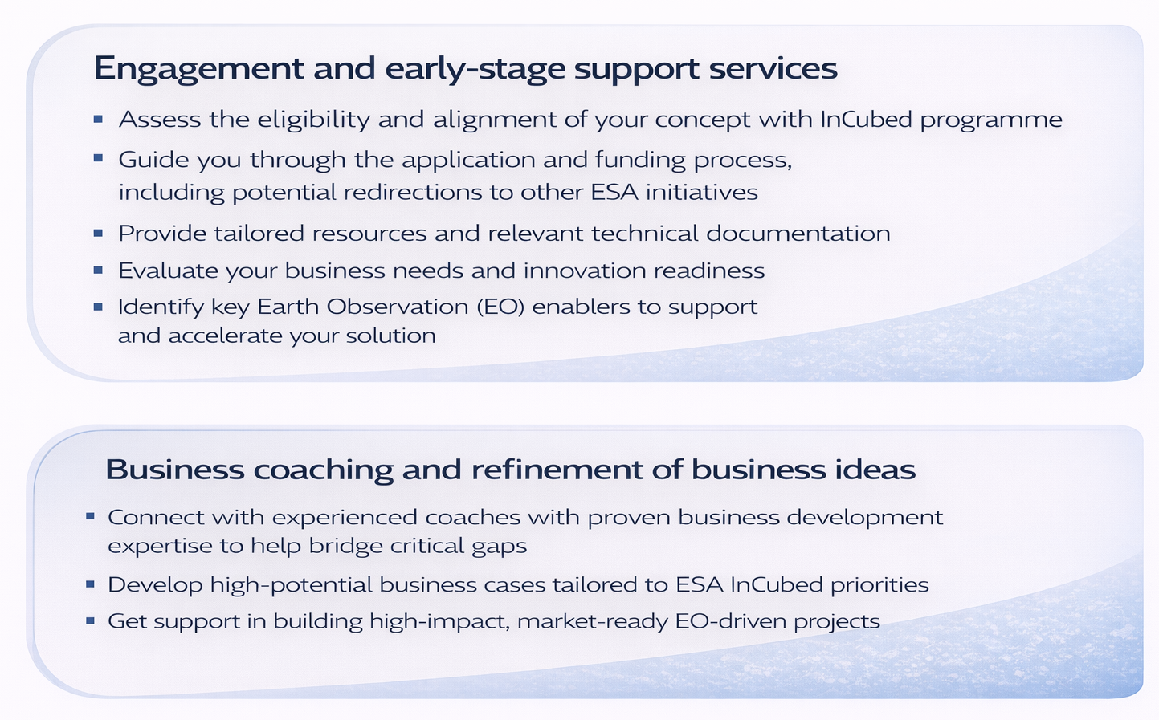
Our business support along the journey
Engagement and early-stage support services
Assess the eligibility and alignment of your concept with InCubed programme
Guide you through the application and funding process, including potential redirections to other ESA initiatives
Provide tailored resources and relevant technical documentation
Evaluate your business needs and innovation readiness
Identify key Earth Observation (EO) enablers to support and accelerate your solution
Business coaching and refinement of business ideas
Connect with experienced coaches with proven business development expertise to help bridge critical gaps
Develop high-potential business cases tailored to ESA InCubed priorities
Get support in building high-impact, market-ready EO-driven projects

Slide 10

Some project examples for inspiration (1/5)
AIX - Artificial Intelligence for Smart EO Data Distribution
Application: Platform for on-orbit processing and decentralized distribution of Earth Observation (EO) data, leveraging artificial intelligence and blockchain technologies on CubeSats.
Partners: Planetek Italia, D-Orbit, AIKO.
Target Stakeholders: IoT companies, AI developers, satellite operators, space-tech startups.
Relevance:
Demonstrates cutting-edge innovation in the smart space segment (edge computing)
Enables real-time, autonomous EO data services directly from orbit
Supports data sovereignty and trust via blockchain-backed processing

Slide 11

Some project examples for inspiration (2/5)
SaferPlaces: an AI-based digital twin platform for flood risk intelligence in urban areas
Application: EO-driven platform using artificial intelligence to quantify physical climate risks (e.g. floods, wildfires, extreme heat) and support resilience planning for assets, territories and portfolios
Partners: GECOsistema, MEEO
Target Stakeholders: Insurance and reinsurance, banks and investors, public authorities, infrastructure operators, corporate risk teams.
Relevance:
Shows how EO + AI enable operational climate risk analytics for real-world decision making
Bridges space data with financial, infrastructure and urban resilience use cases
Demonstrates scalable downstream EO services aligned with ESG and adaptation needs

Slide 12

Some project examples for inspiration (3/5)
TESLA VISION is an Earth Observation mission delivering Radio Frequency reconnaissance Data As A Service (DAAS) via web-portal.
Application: Cloud-native platform for automated ingestion, processing and analysis of multi-mission Earth Observation data to generate geospatial intelligence products at scale.
Partners: Intecs Solutions, ARCA Dynamics, NPC Spacemind, CNR-IIA
Target Stakeholders: Public sector agencies, utilities, environmental monitoring organisations, infrastructure managers, geospatial service providers.
Relevance:
Demonstrates industrialisation of EO exploitation through platform-based analytics
Reduces time from satellite data to actionable information
Enables rapid development of downstream services across multiple sectors

Slide 13

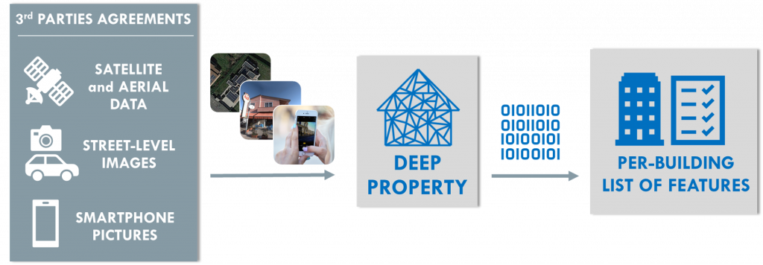
Some project examples for inspiration (4/5)
DEEP PROPERTY
Application: Automated extraction of detailed building features using proprietary AI applied to geospatial datasets (satellite, street‑level imagery, etc.). Delivered as a cloud-based SaaS via API.
Partners: Ticinum Aerospace.
Target Stakeholders: Insurance, reinsurance, and risk modelling companies; also relevant to real estate, energy, and ESG rating sectors.
Relevance:
Provides high-quality, per-building risk data which improves underwriting, pricing, and risk models compared to aggregated datasets.
Reduces uncertainty in risk estimation, enabling more competitive insurance policies and resilience to climate-change-driven losses.

Slide 14

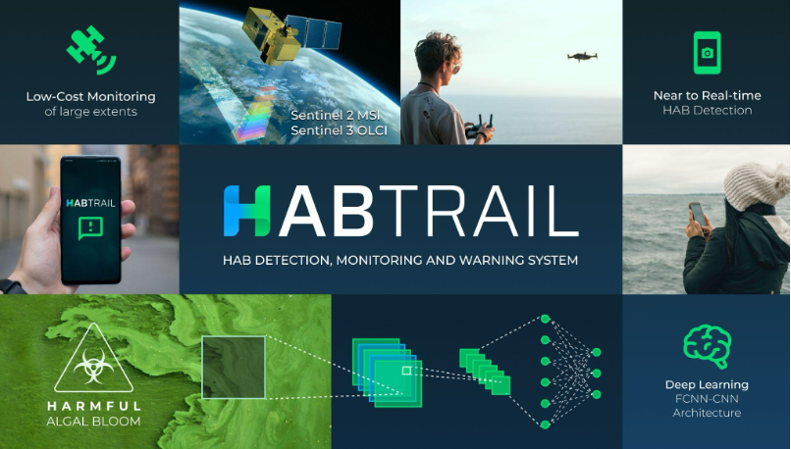
Some project examples for inspiration (5/5)
HABTRAIL — AI Early Warning for Marine Risks.
Application: AI-powered platform predicting and monitoring Harmful Algal Blooms using satellite and in-situ data, providing early warnings and risk insights via a web dashboard.
Partners: Eyecon Group (Portugal).
Target Stakeholders: Aquaculture operators, public health authorities, regulators, tourism sector, insurance companies.
Relevance:
Demonstrates EO + AI delivering predictive environmental intelligence
Bridges space data with concrete economic sectors (aquaculture, tourism, insurance)
Moves monitoring from reactive to proactive decision-making

Slide 15
Stefano Carosio
s.carosio@stamtech.com

