Slide 1


Slide 2

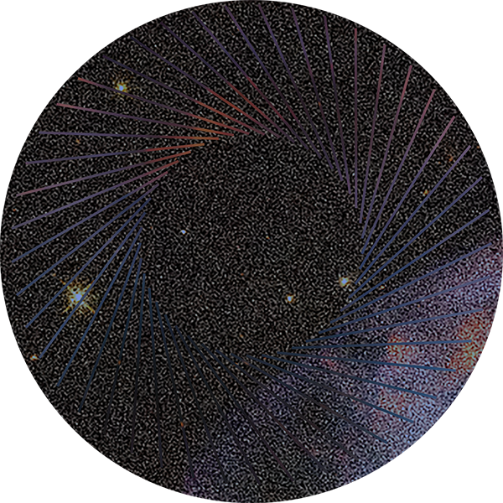
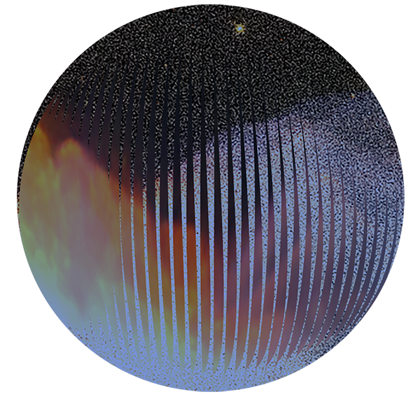
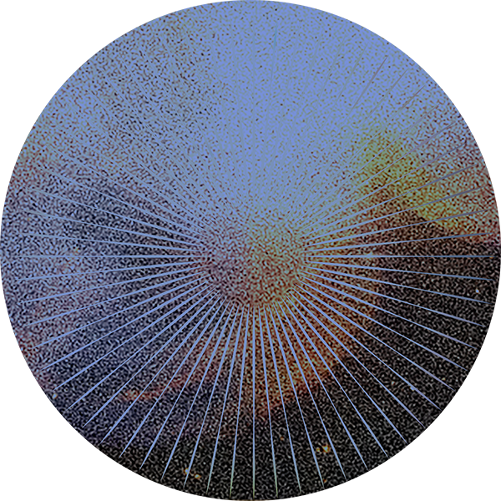
L’intelligenza Artificiale applicata ai dati di Osservazione
della Terra per lo sviluppo di nuove applicazioni
Stefano Natali, MEEO, Ferrara

Slide 3

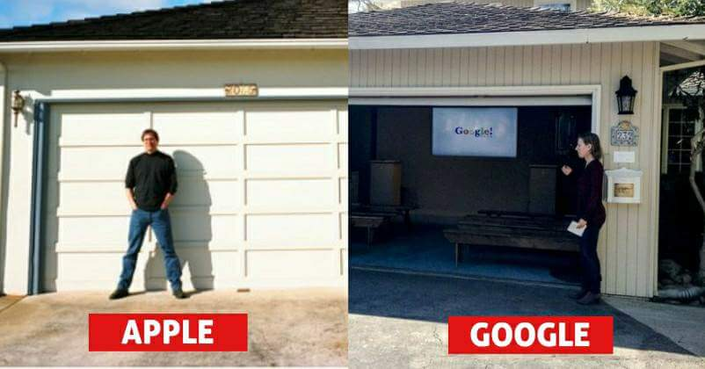
01/04/1976
04/09/1998

Slide 4
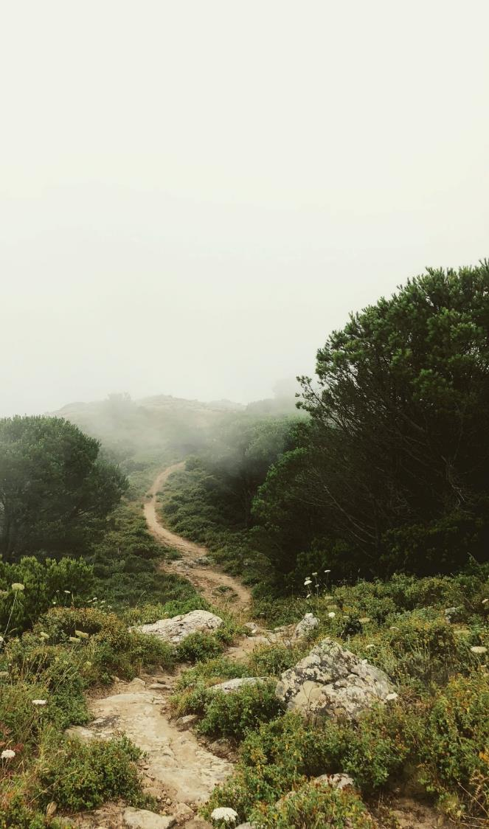






~ 50 People
International Team: 13 nationalities
Global Market – Continuous Evolution
Brands & Web & Socials
@platformAdam
@platformAdam
adamplatform.bsky.social

Slide 5


MISSION
we develop tools to access, process, and translate the huge amount of available environmental data into useful insights
Information mining
Physical-based and ML/DL/AI based tools are key elements for thematic data information mining
Datacube for geospatial data access
Satellites, models, ground measurements provide countinuous observations of the whole Earth system
MEEO Srl. 2026 - Commercial in confidence

Slide 6
WHAT DO WE EXPECT FROM AI
Learning from Data (Machine Learning)
Simulation of Human Intelligence
Autonomous Action & Optimization
MEEO Srl. 2026 - Commercial in confidence
6

Slide 7
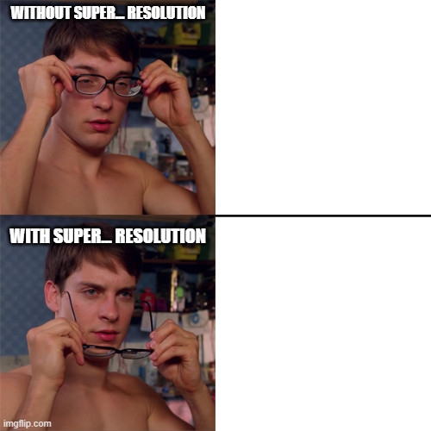
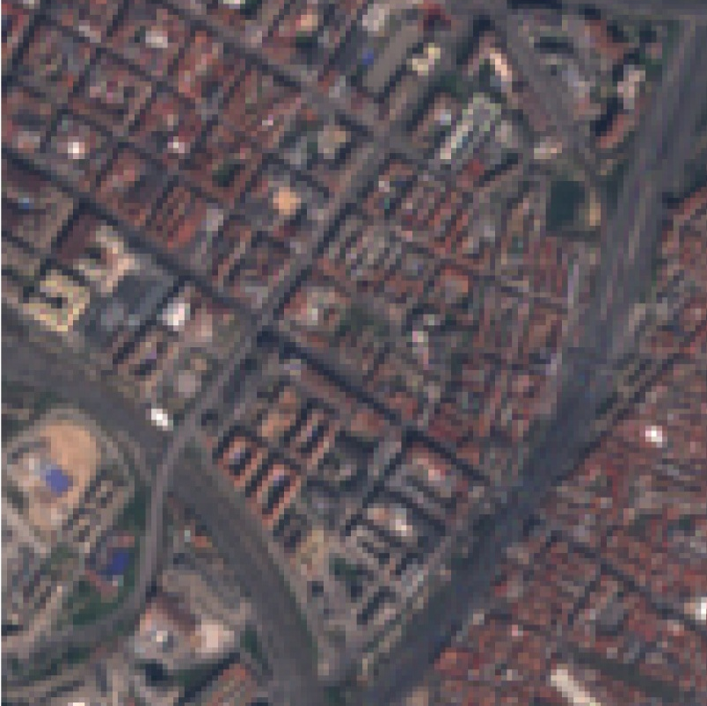
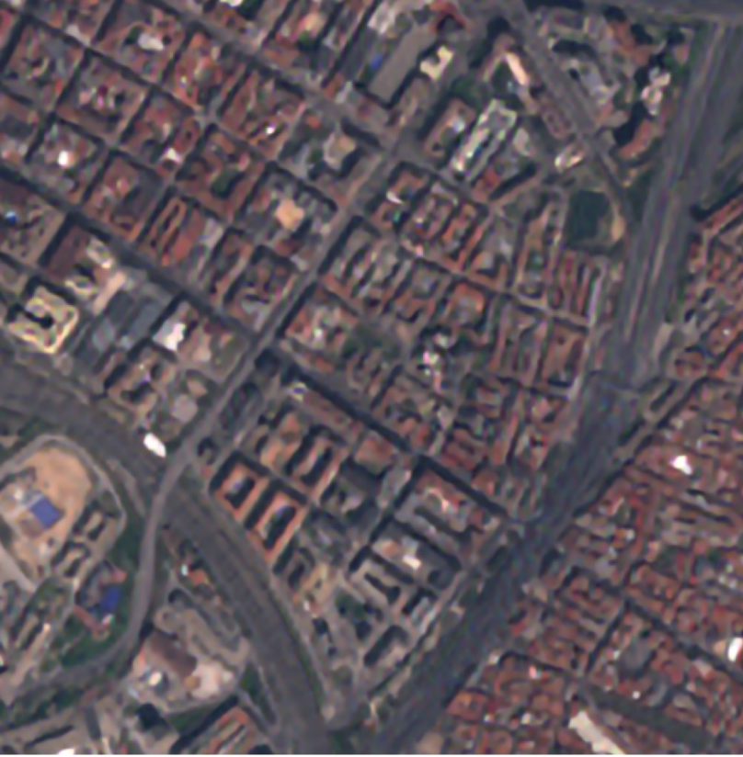
SUPER RESOLUTION
a computational technique using AI and algorithms to increase the resolution and detail of satellite imagery
Deep learning models (CNN) trained with high resolution data to reconstruct missing high-frequency details, refine edges, and improve visual quality
MEEO Srl. 2026 - Commercial in confidence

Slide 8
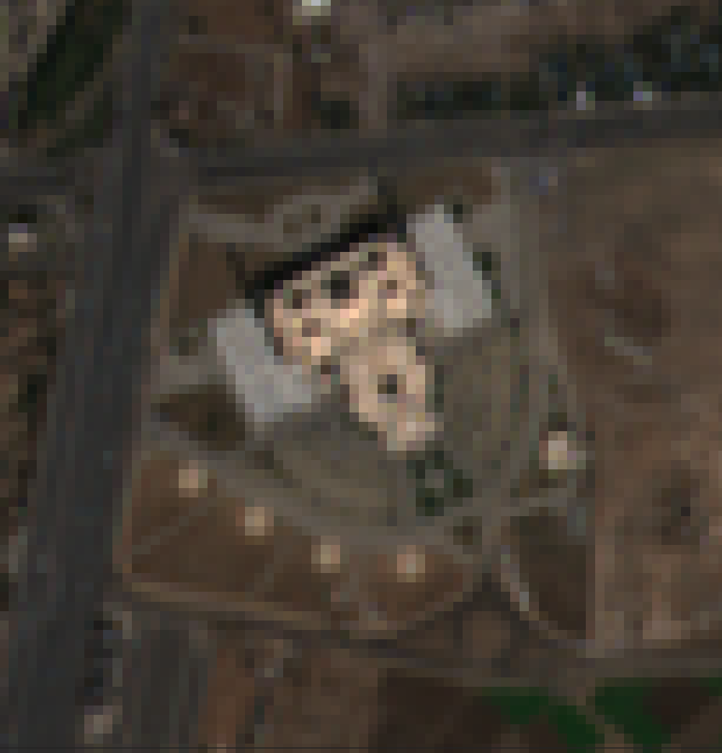
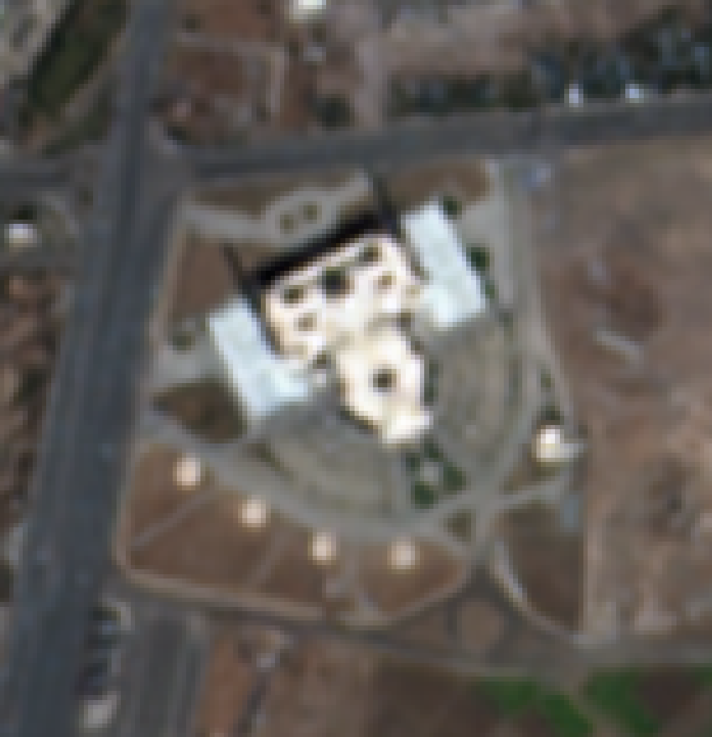
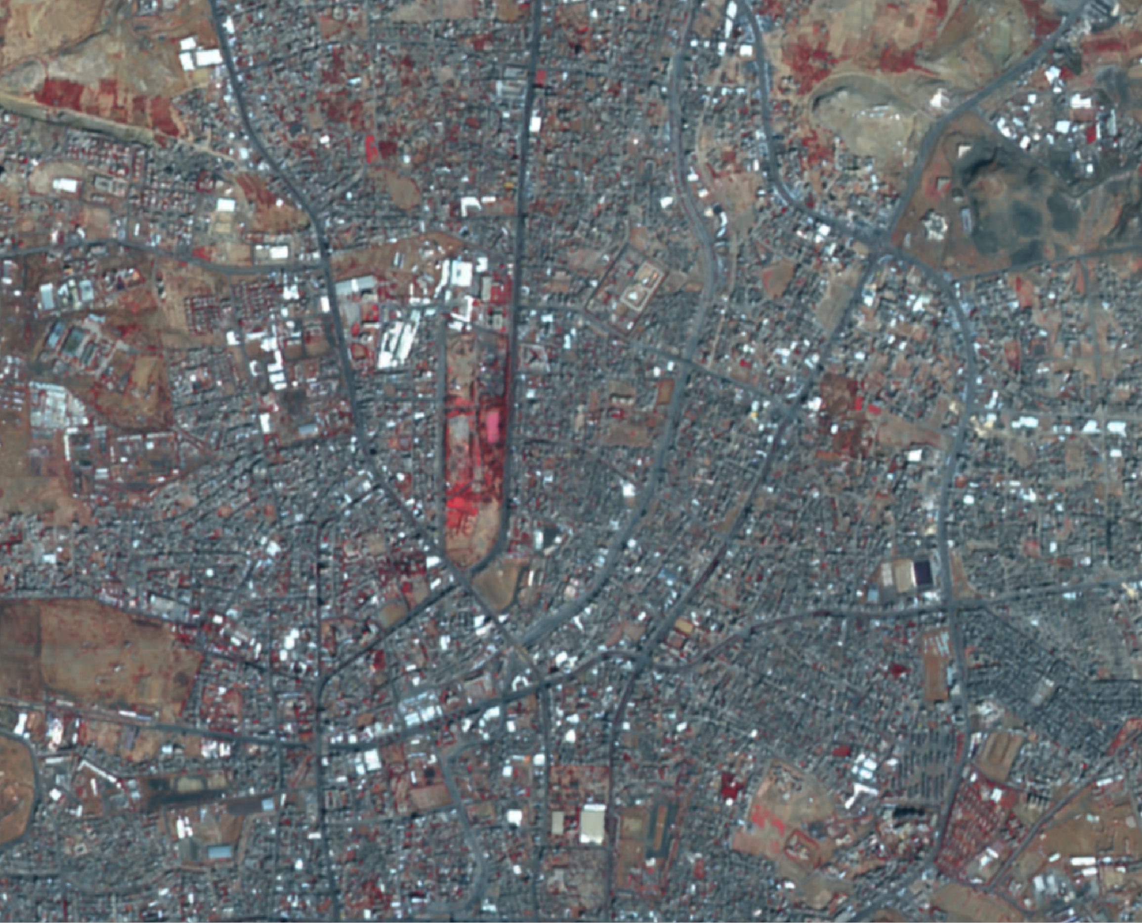
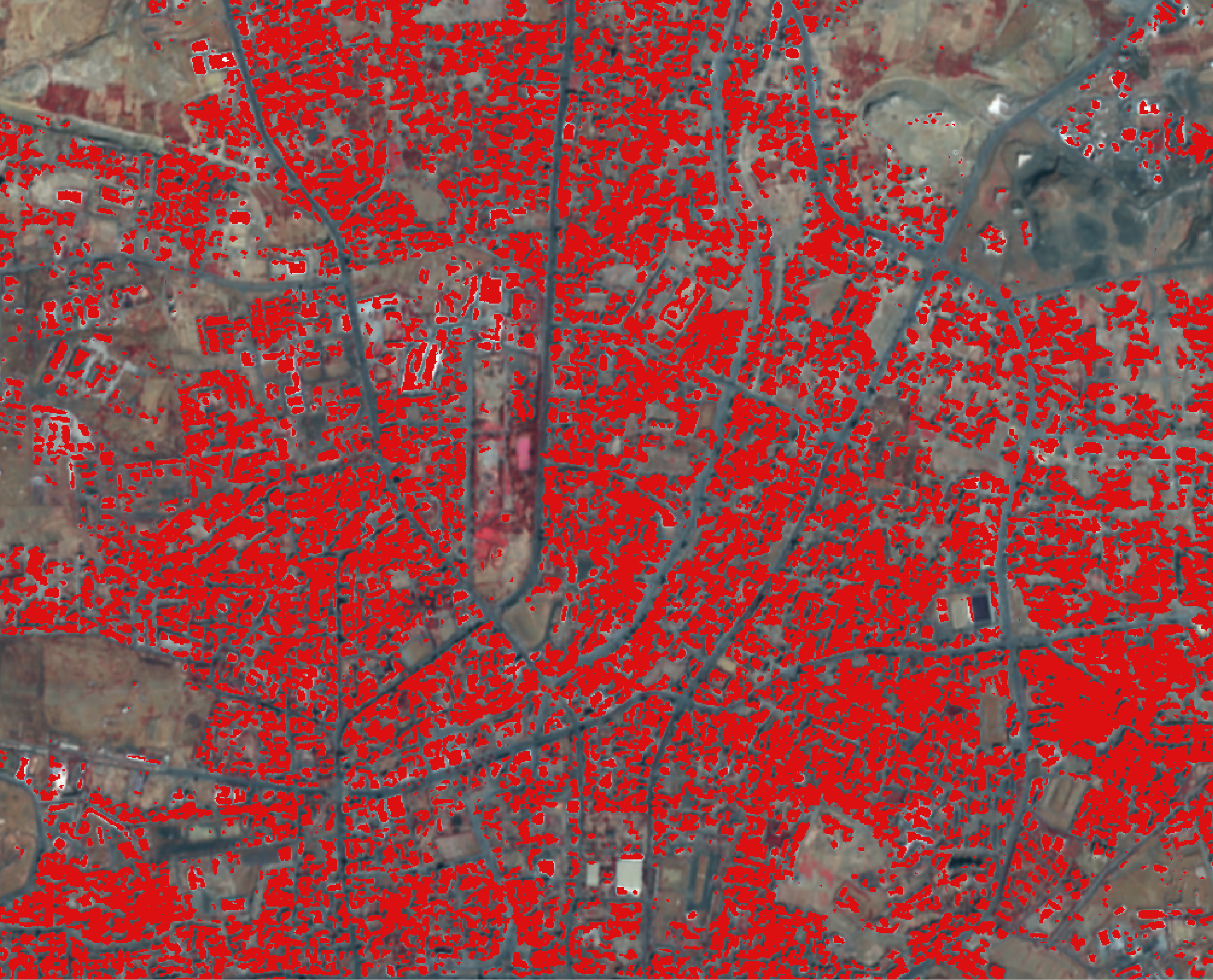
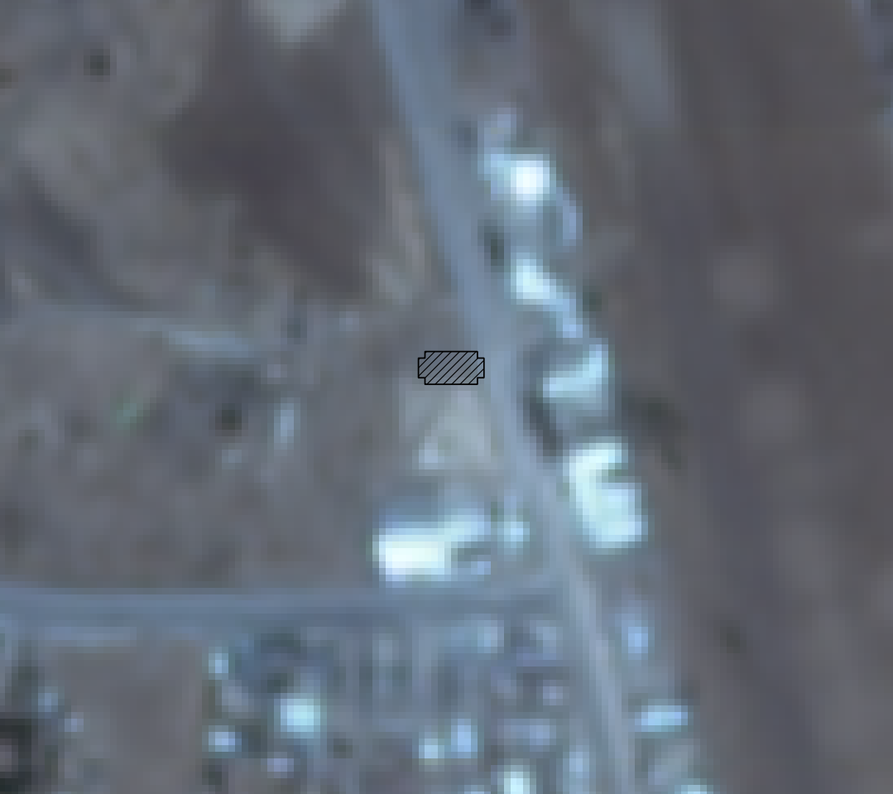
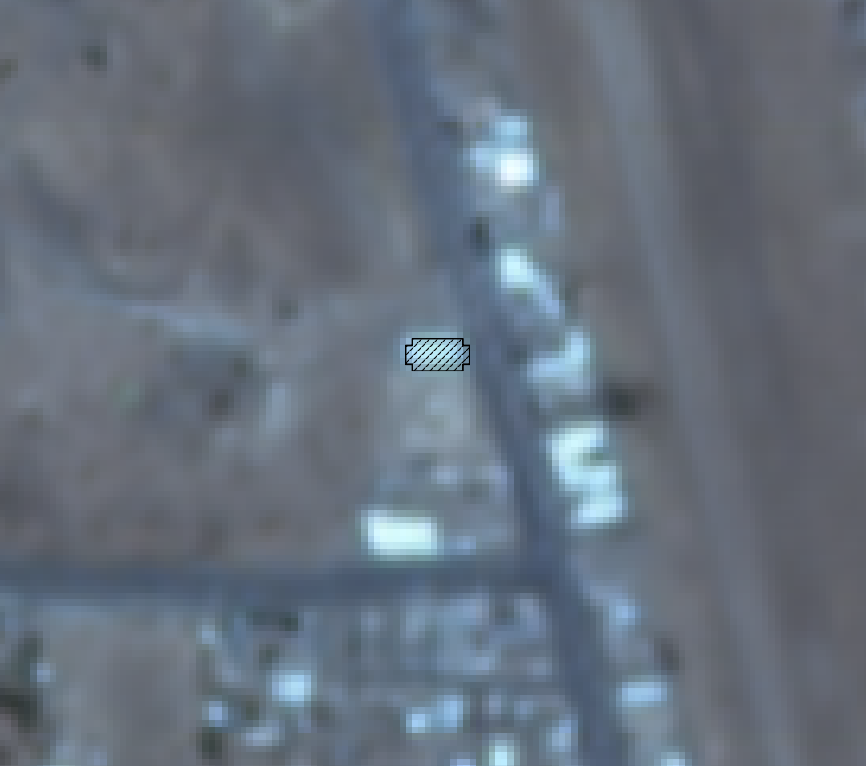
AI-BASED AUTOMATIC CHANGE DETECTION WORKFLOW
Objective 1
Objective 2
Objective 3
Sentinel-2
Sentinel-2 (SR)
Super resolution
Buildings classification
Object-based change detection
Temporal classification
Worldview-2
PlanetLab
Open Building Dataset
x3
MEEO Srl. 2026 - Commercial in confidence
8

Slide 9
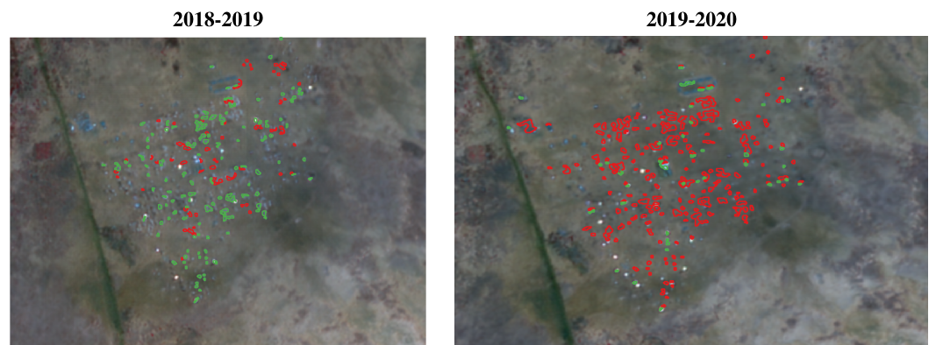
ACHIEVEMENT – DISPLACELEMENT
MOVEMENT
Displacement Movement - Burkina Faso - Goudoubo, New build Shelters in green and removed shelters in red between 2018 and 2019 an increase can be seen, while between 2019 and 2020 most of the shelters has been removed
MEEO Srl. 2026 - Commercial in confidence
9

Slide 10
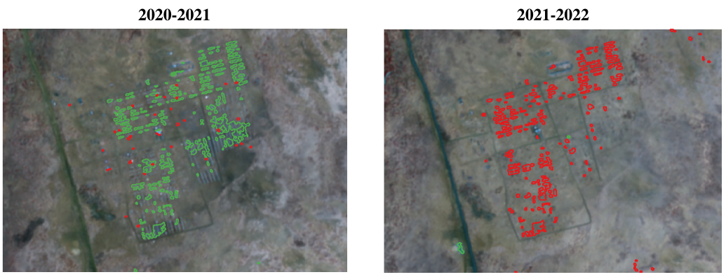
ACHIEVEMENT – DISPLACELEMENT
MOVEMENT
Displacement Movement - Burkina Faso - Goudoubo, New build Shelters in green and removed shelters in red between 2020 and 2021 an big increase can be seen, while between 2021 and 2022 the camp seems to be abandoned
MEEO Srl. 2026 - Commercial in confidence
10

Slide 11
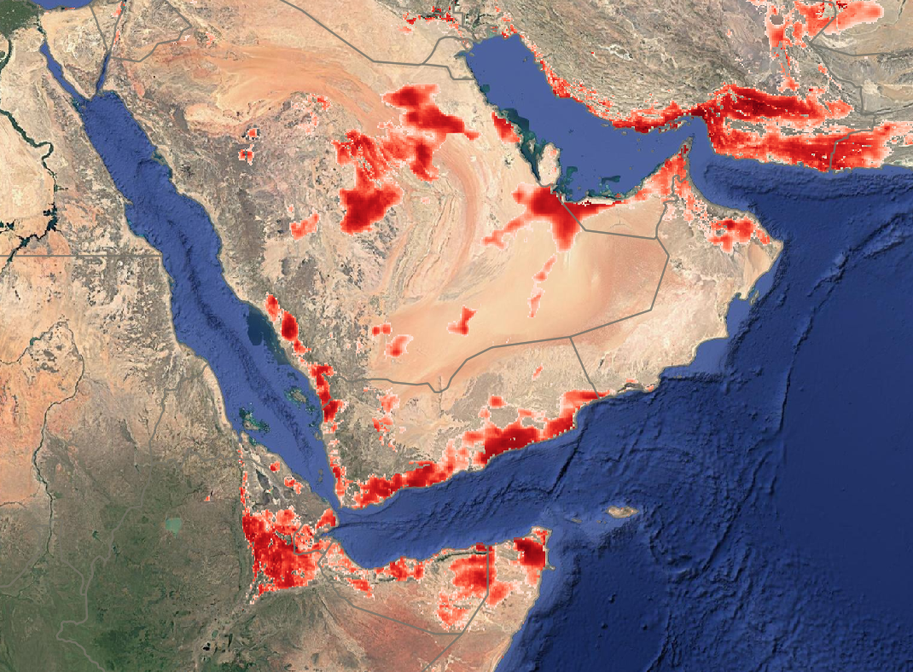
DESERT LOCUST
MONITORING SERVICE
MEEO Srl. 2026 - Commercial in confidence

Slide 12
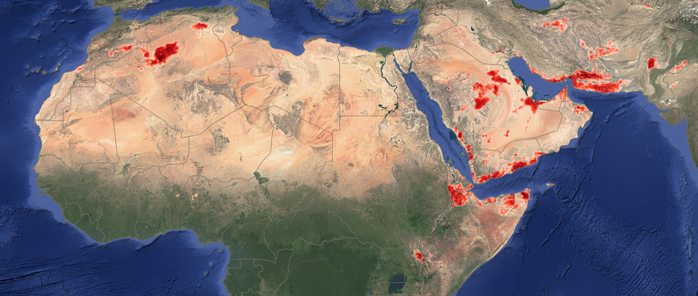




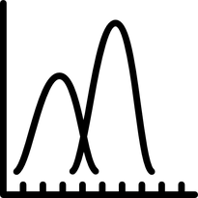
FUTURE SUITABLE ECOSYSTEM ESTIMATION
Input variables
Model
Week 1
Results:
  Accuracy: 78%
  Area predicted as presence: ~1.1%
  Recall: 30%
  Precision: 83%
Week 2
Surface temeprature (Era5-Land)
Week N
Precipitation (Era5-Land)
Soil moisture (Era5-Land)
What the model sees:
  50 days of data
  Splitted in 10 time steps
  Each is a 5 days average
NDVI (Modis)
RNN-Maxent
RNN-Maxent:
  Combines Recurrent Neural network and Maxent Capabilities
  Analyze time series
  Preserves Maximum Entropy principles
Probability of presence:
  7 days in advance
Probability of presence
MEEO Srl. 2026 - Commercial in confidence
0.9
1

Slide 13
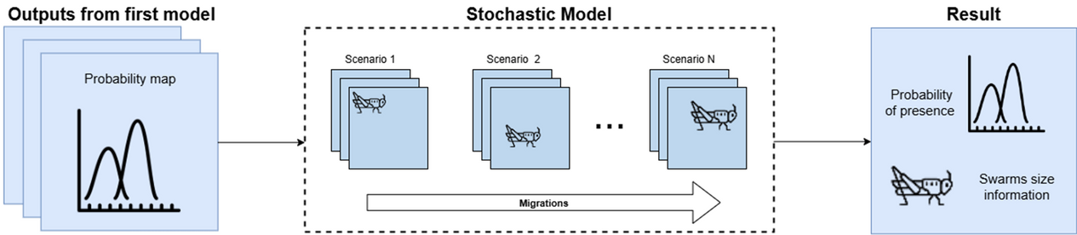

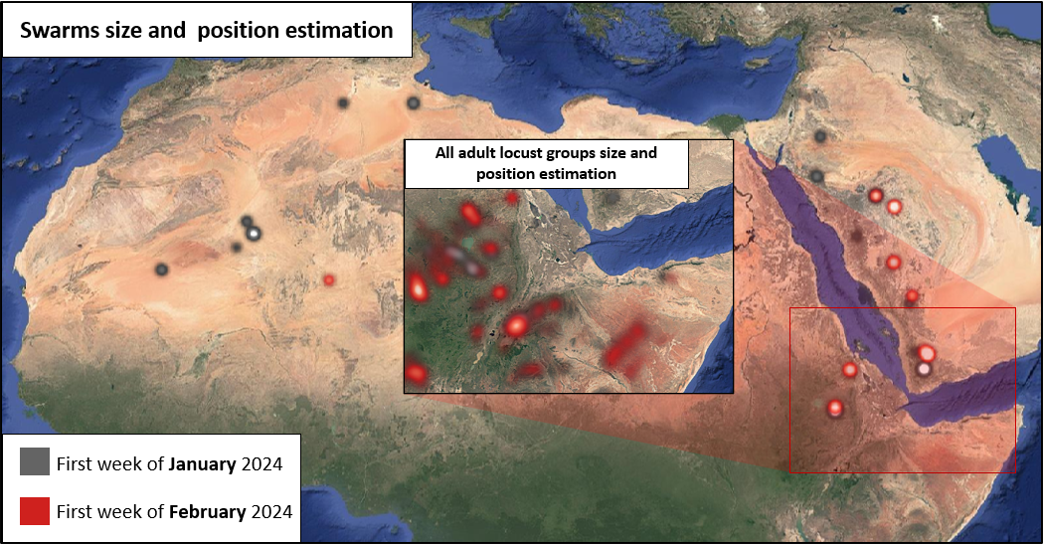




DESERT LOCUST MOVEMENT ESTIMATIONS
Description
On top of the outputs generated by the ecosystem estimation, we built:
  A stochastic migration model that performs a multi-scenarios risk analysis
  Aimed at predicting potential migrations patterns of desert locust swarms
  Incorporating satellite climate data and locust behaviours.
Input:
Air Temperature
Leaf Area Index (LAI)
Wind speed and direction
Locust biology
MEEO Srl. 2026 - Commercial in confidence

Slide 14
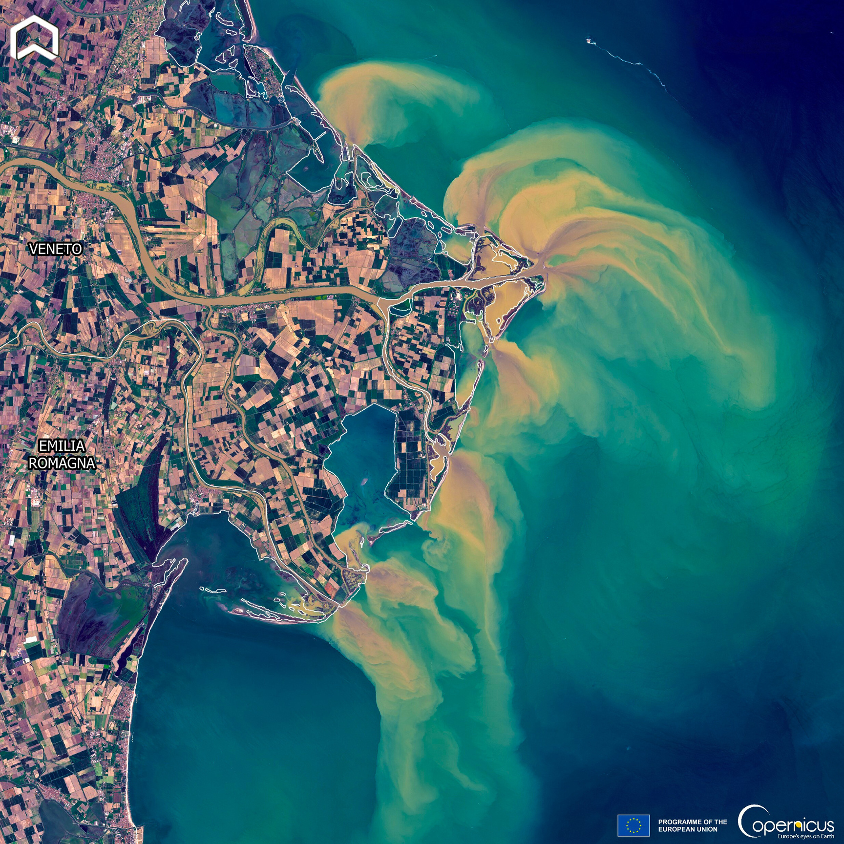
SMART PROJECT
Sensibilization and Mobilitation for an Active green tRansiTion

Slide 15
SMART PROJECT
MEEO Srl. 2026 - Commercial in confidence

Slide 16
MEEO Srl. 2026 - Commercial in confidence

Slide 17

AGENTIC APPROACHES
MEEO Srl. 2026 - Commercial in confidence

Slide 18
Geospatial data:
Satelllites
Models
Ground data
Socio-economic information
Service for hydrology e.g. alert events, flooded maps, what if scenarios
LLM
Traditional tools
VLM
Agent
Service for communication (text, images, infographics)
Mon-Geospatial data:
Documentation
Socio-economic information
Health data
...
Discovery / access
RAG
Human
Service for civil security, food security personal security
MEEO Srl. 2026 - Commercial in confidence
18

Slide 19
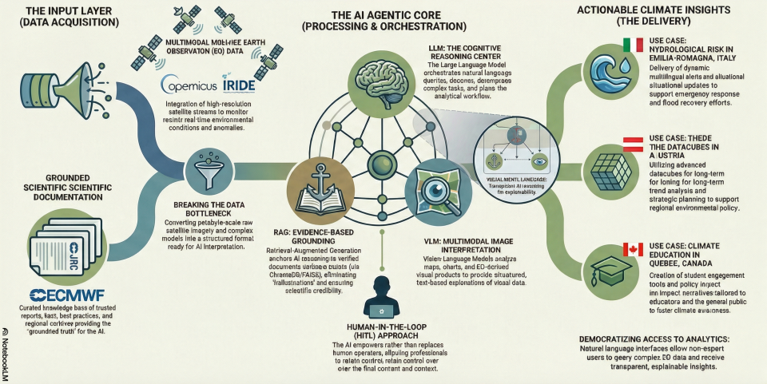
MEEO Srl. 2026 - Commercial in confidence
19

Slide 20
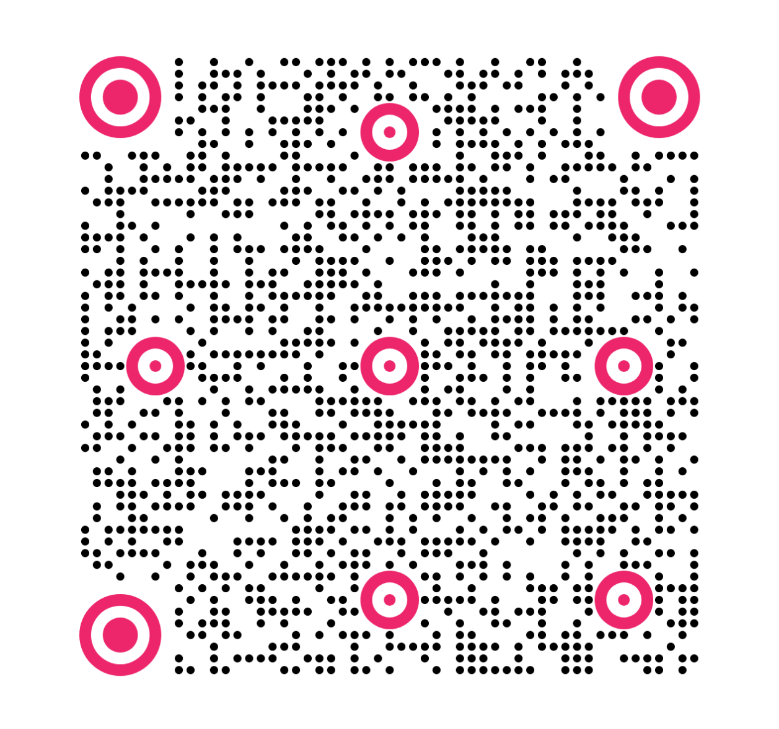
MEEO Srl
www.meeo.it
Via Antonio Frizzi 21
Ferrara
natali@meeo.it
MEEO Srl. 2026 - Commercial in confidence
20

